Slide 1
CSC 470 Computer Graphics
Summary of OpenGL Primitives

Slide 2
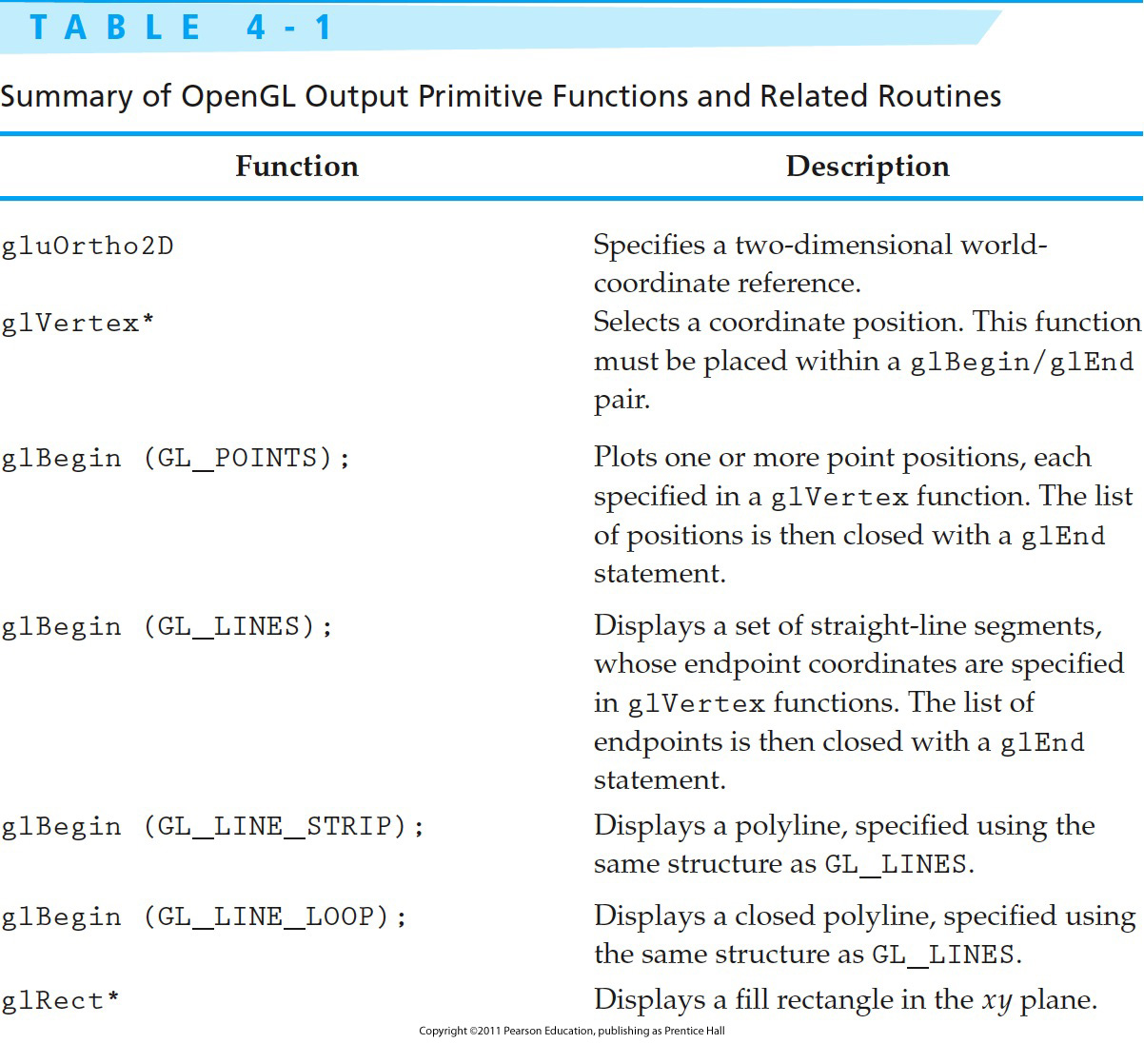
Table 4-1 Summary of OpenGL Output Primitive Functions and Related Routines

Slide 3
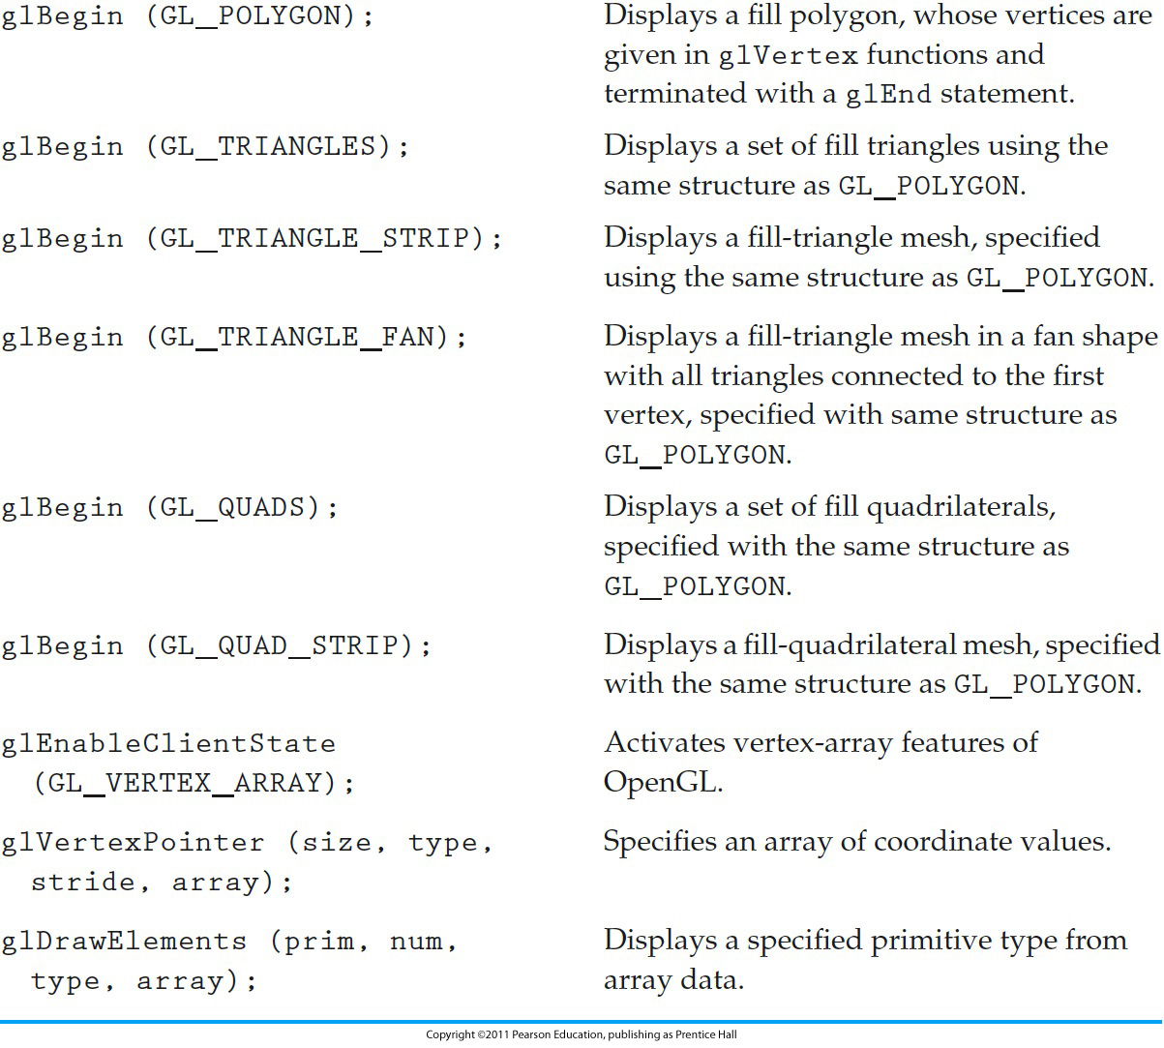
Table 4-1 (continued) Summary of OpenGL Output Primitive Functions and Related Routines
Notes:
3

Slide 4
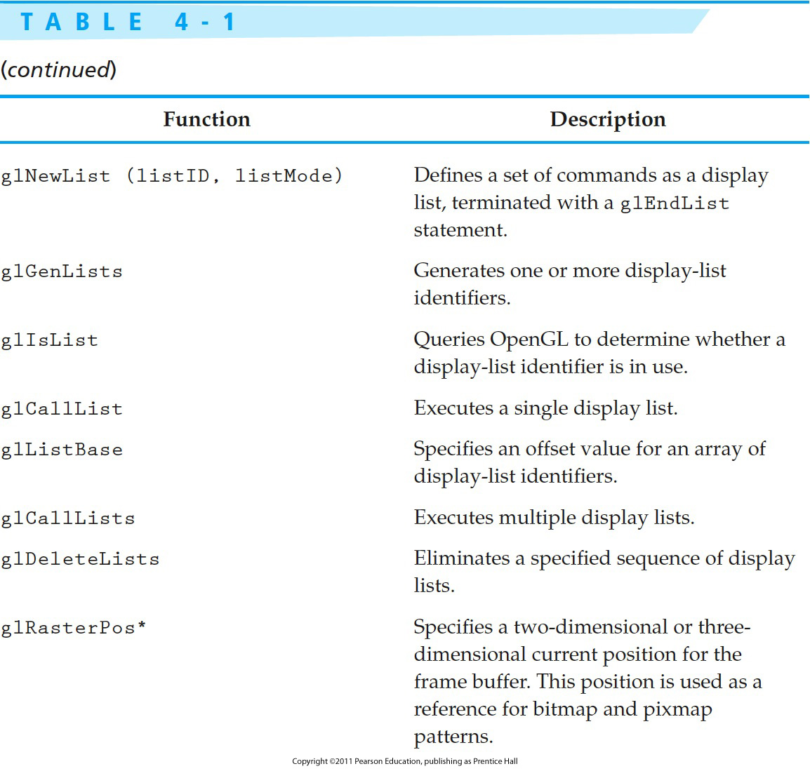
Table 4-1 (continued) Summary of OpenGL Output Primitive Functions and Related Routines
Notes:
4

Slide 5
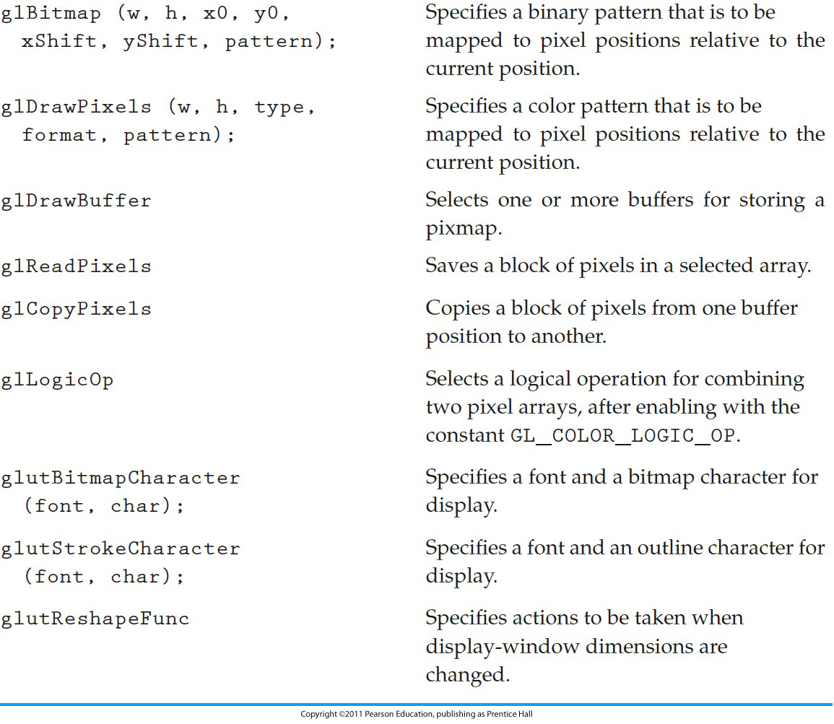
Table 4-1 (continued) Summary of OpenGL Output Primitive Functions and Related Routines
Notes:
5

